Slide 1

INT 200 : HUMAN POSE ESTIMATION
FOR DIABETES DISORDER USING DEEP LEARNING TECHNIQUE
INT 200 Internship
First Review
Team Members
1. Daffney Christina (E0421032)
Project Guide:
Prof.B.Nirmala

Slide 2
Agenda
Introduction
Problem statement
Research survey
Work Flow
Work Done
Timeline of the work
References

Slide 3
Introduction
Human pose estimation (HPE), which has been extensively studied in computer vision literature, involves estimating the configuration of human body parts from input data captured by sensors, in particular images and videos.
HPE provides geometric and motion information of the human body which has been applied to a wide range of applications (e.g., human-computer interaction, motion analysis, augmented reality (AR), virtual reality (VR), healthcare, etc.).
With the rapid development of deep learning solutions in recent years, such solutions have been shown to outperform classical computer vision methods in various tasks including image classification, semantic segmentation and object detection.

Slide 4
Problem statement (1/3)
DIABETES:
Diabetes is a condition which affects a person's metabolic system as the glucose level rises because of inadequate insulin production or due to the insufficient response of the body to insulin.
Symptoms: Hunger and fatigue, peeing more often and being thirstier, dry mouth and itchy skin, blurred vision.
Yoga is the best way to adjust your blood sugar levels to normal. Yoga keeps your stress level low, protects against cardiac diseases, prevents diabetic neuropathy, and boosts strength and balance to promote overall health.

Slide 5
Problem statement (2/3)
Therapeutic Role of Yoga in Diabetes:
The key factors that increase the risk of Diabetes by 3 times are:
Unhealthy diet patterns
Lack of physical exercises
Psychological stress
Yoga is a set of activities that helps in controlling your stress, and emotions and helps in balancing the body to its perfect shape.

Slide 6

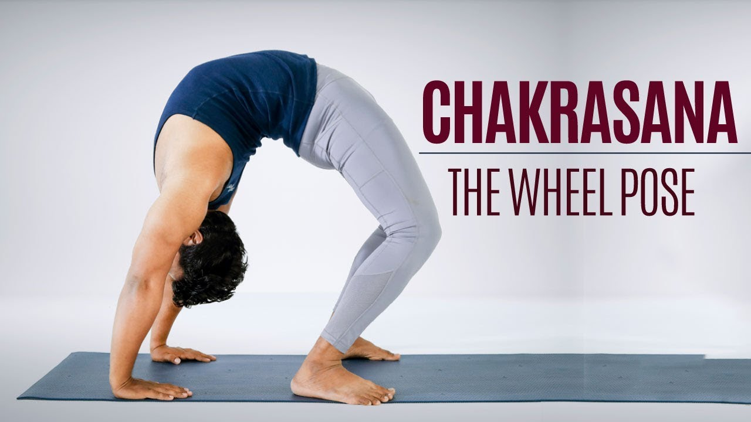

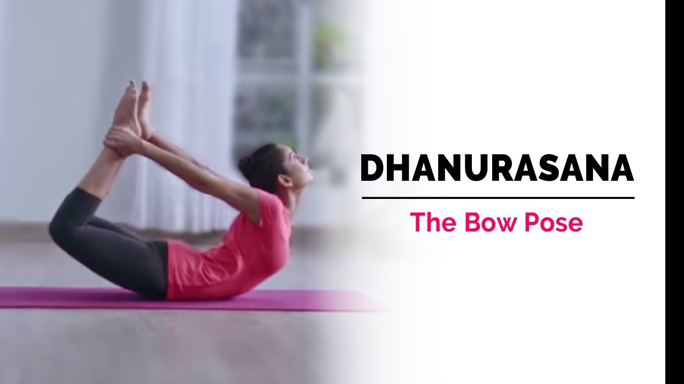
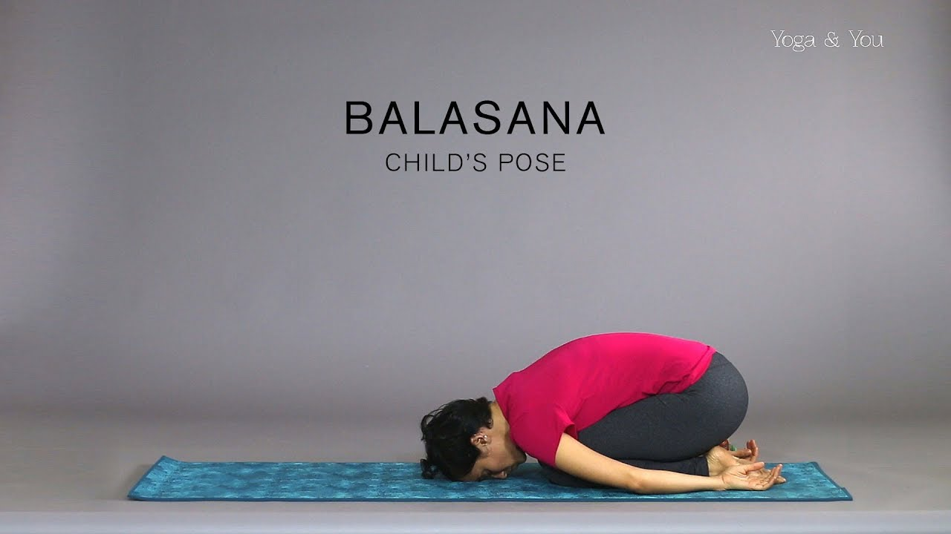
Problem statement (3/3)
Some Yoga poses that helps curing Diabetes

Slide 7
Research survey
S.NO | TITLE | AUTHOR | YEAR | OVERVIEW
1 | Yoga Pose Classification using Deep Learning | Shruthi Kothari | 2020 | Model : SVM Accuracy : 0.9319
2 | Human Pose Estimation via Deep Neural Networks | Alexander Toshev, Christian Szegedy | 2014 | Model : SVM Accuracy : 0.9319

Slide 8
Work Flow
INITIATION
PLANNING
EXECUTION
CLOSURE

Slide 9
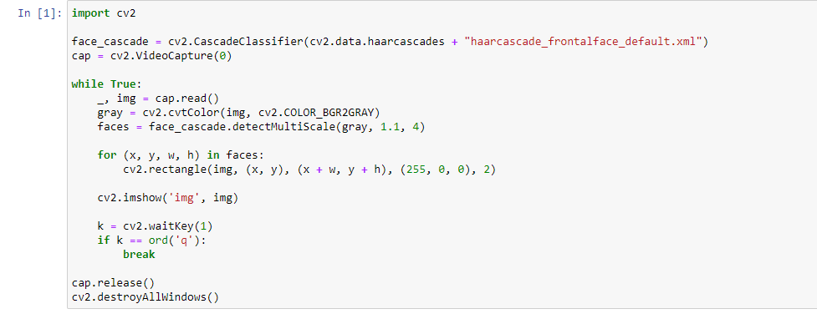
Work done (1/16)
OPENCV – Code on face deduction using webcams
CODE:

Slide 10
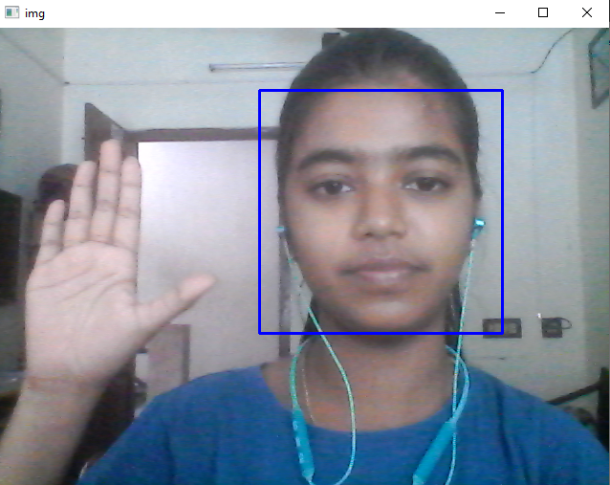
Work done (2/16)

Slide 11
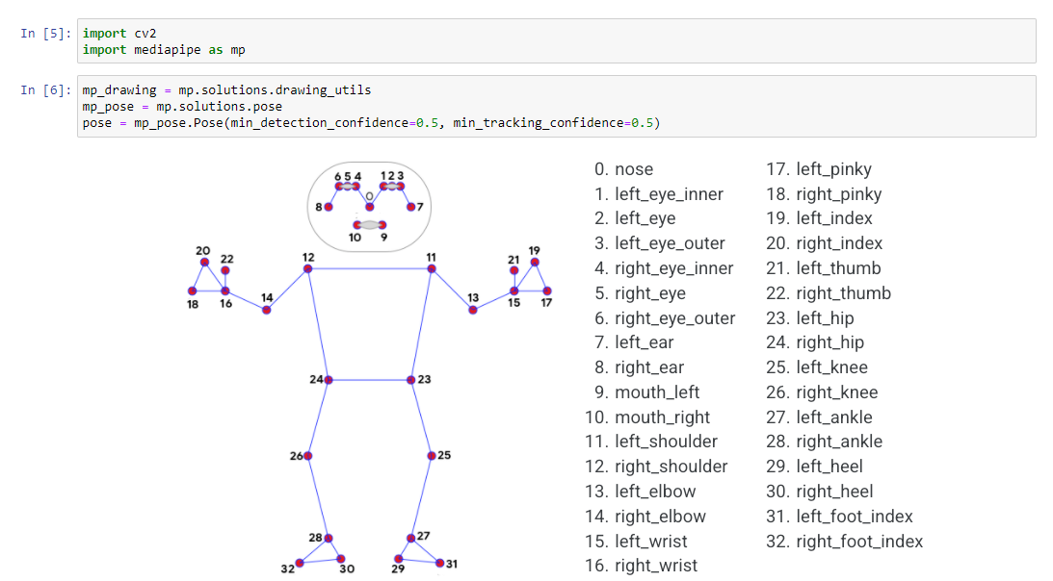
Work done (3/16)
OPENCV – MEDIAPIPE : Real time Human Pose Estimation

Slide 12
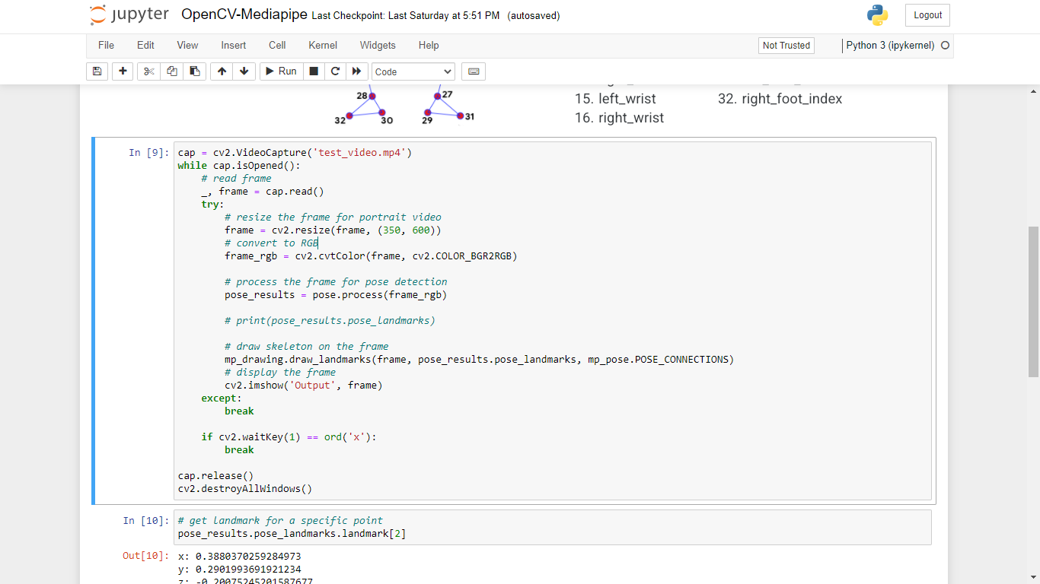
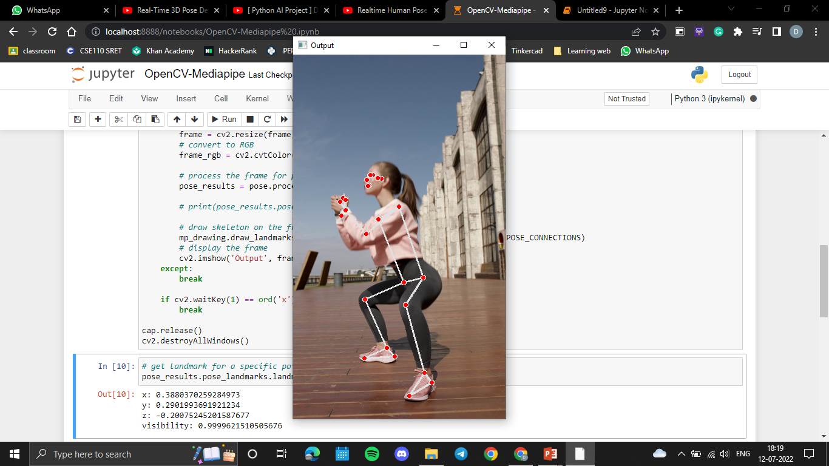
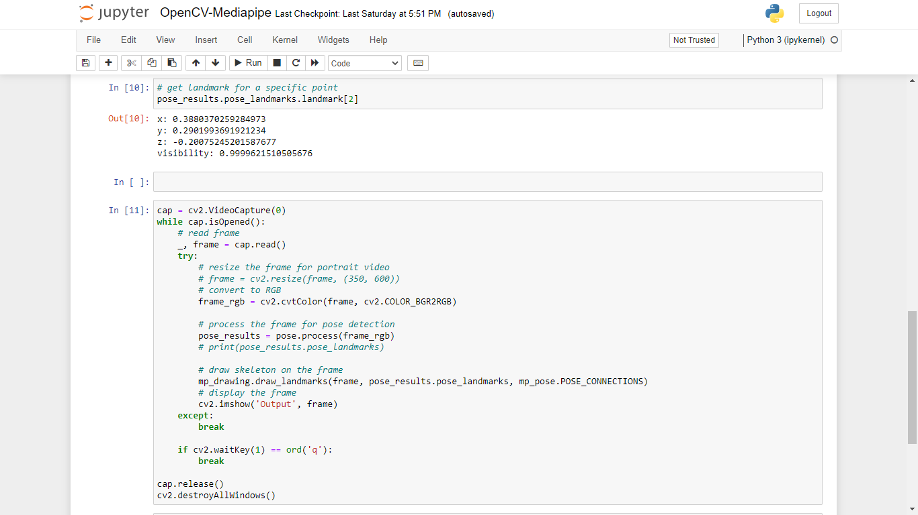
Work done (4/16)
Pose estimation for a video:

Slide 13
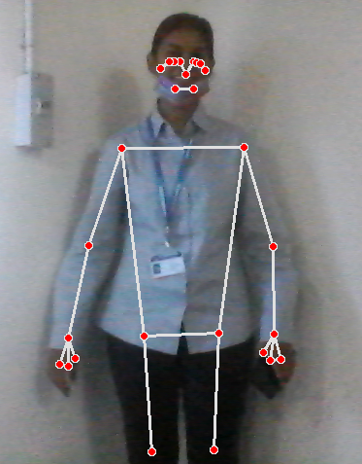
Work done (5/16)
Real time pose estimation

Slide 14
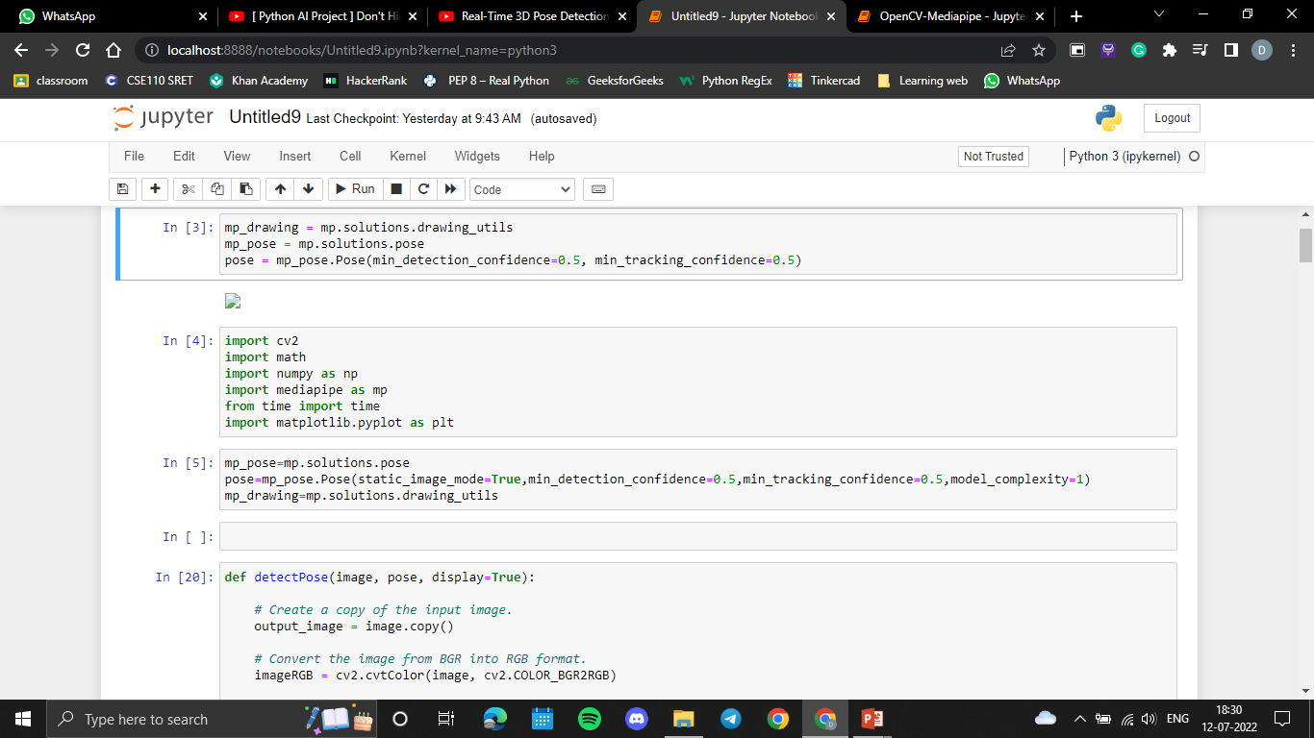
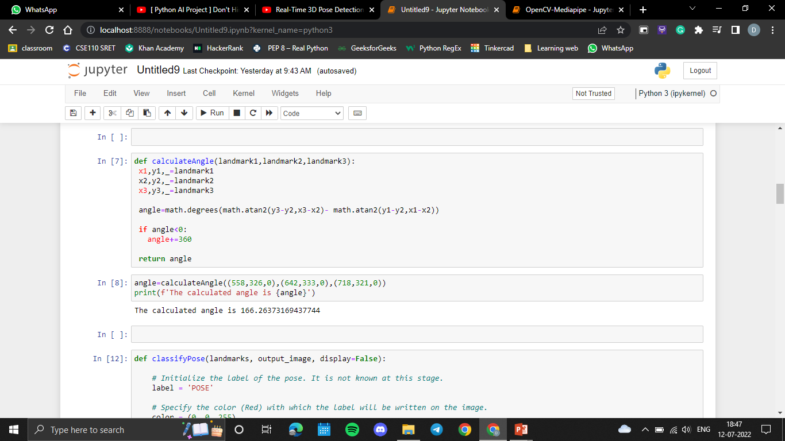
Work done (6/16)
Importing libraries
Initializing and setting up the pose function
Calculating the angle

Slide 15
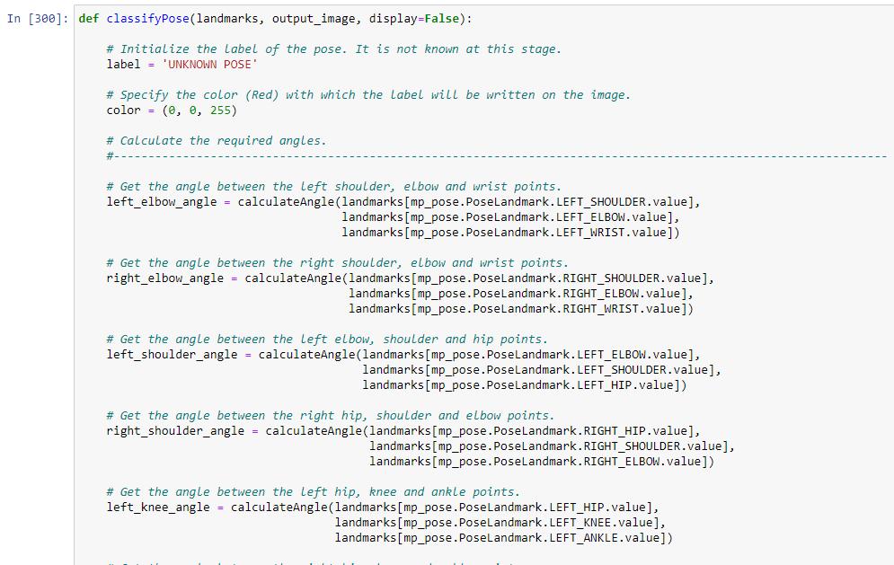
Work done (7/16)
Pose classification with angle between the landmarks

Slide 16
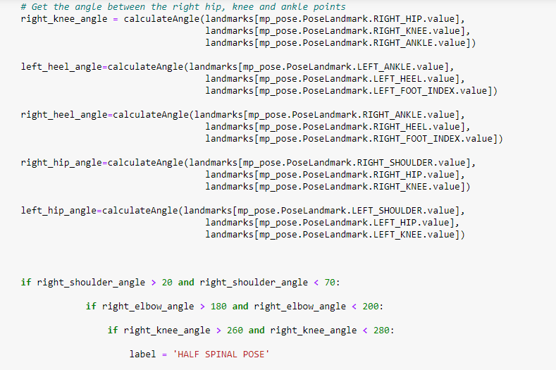
Work done (8/16)

Slide 17
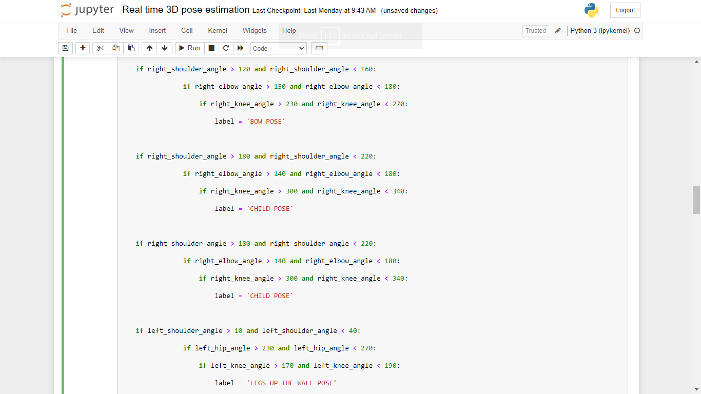
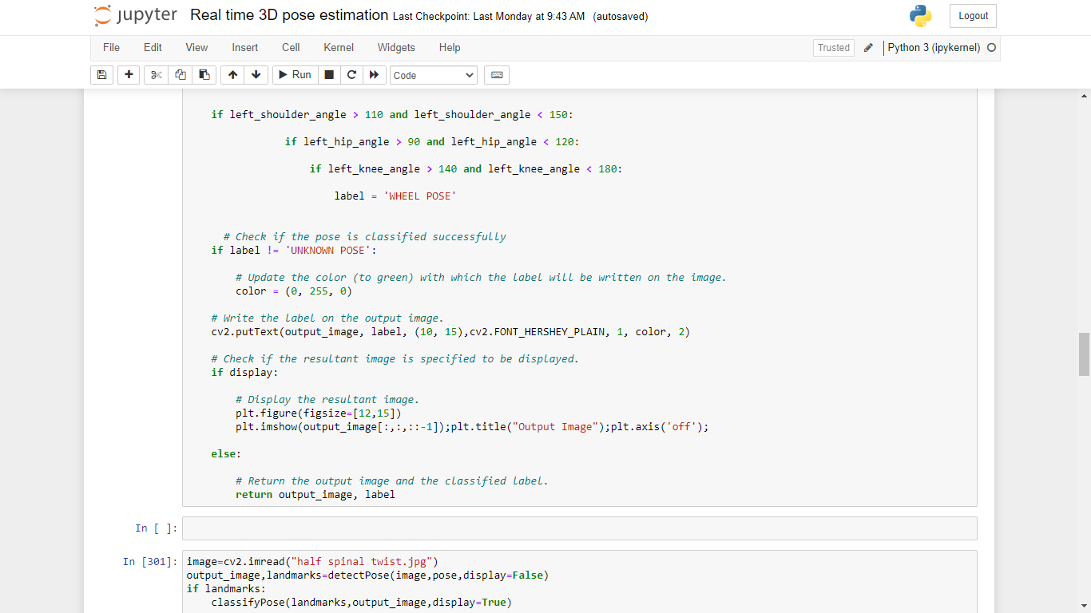
Work done (9/16)

Slide 18
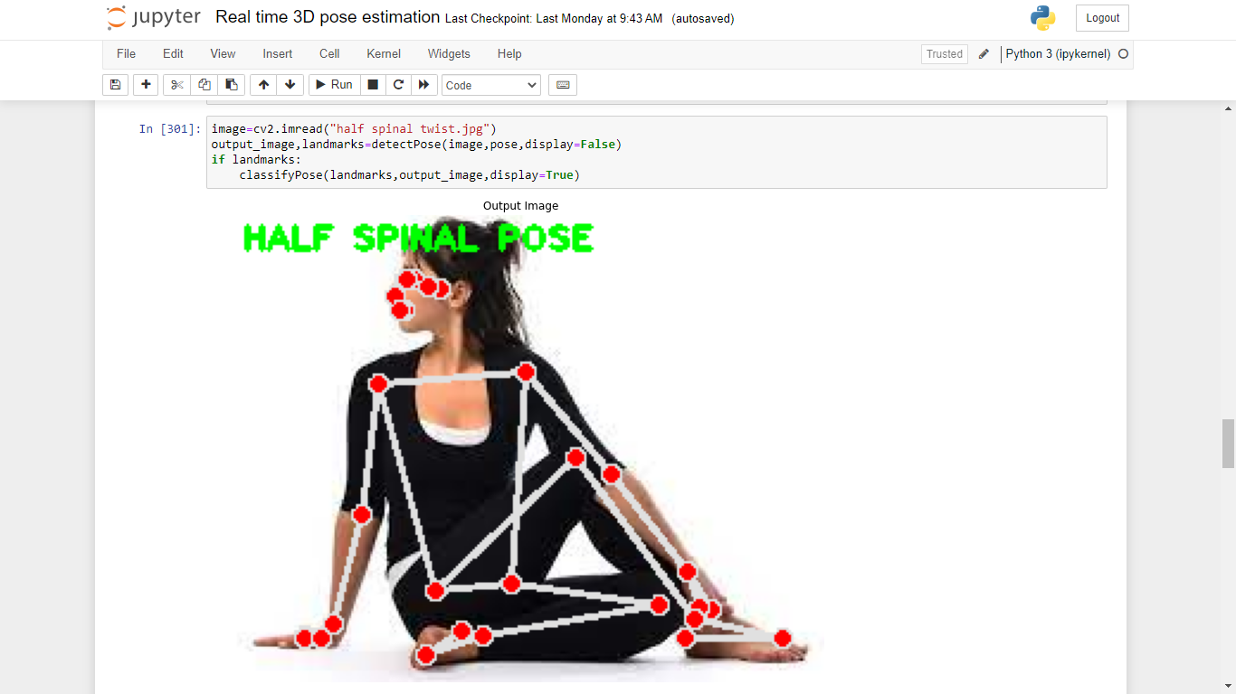
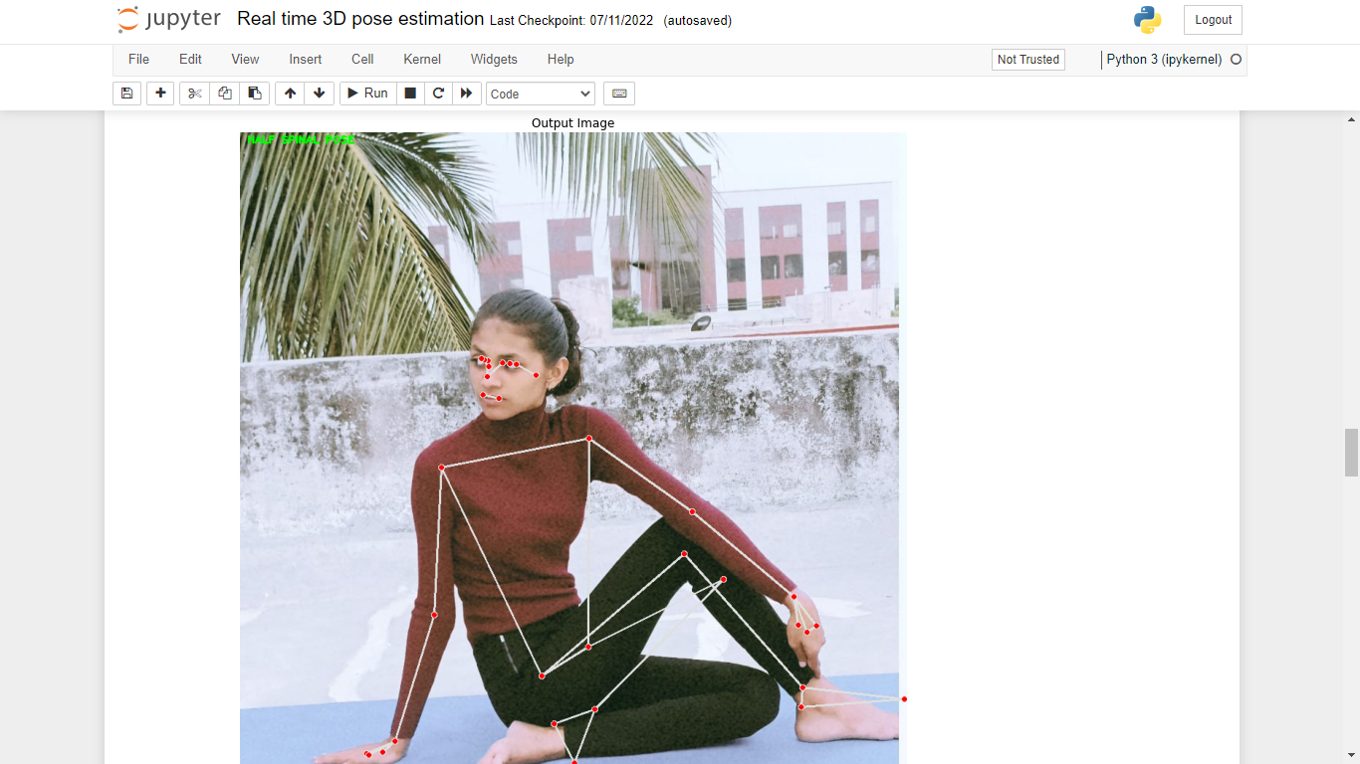
Work done (10/16)

Slide 19
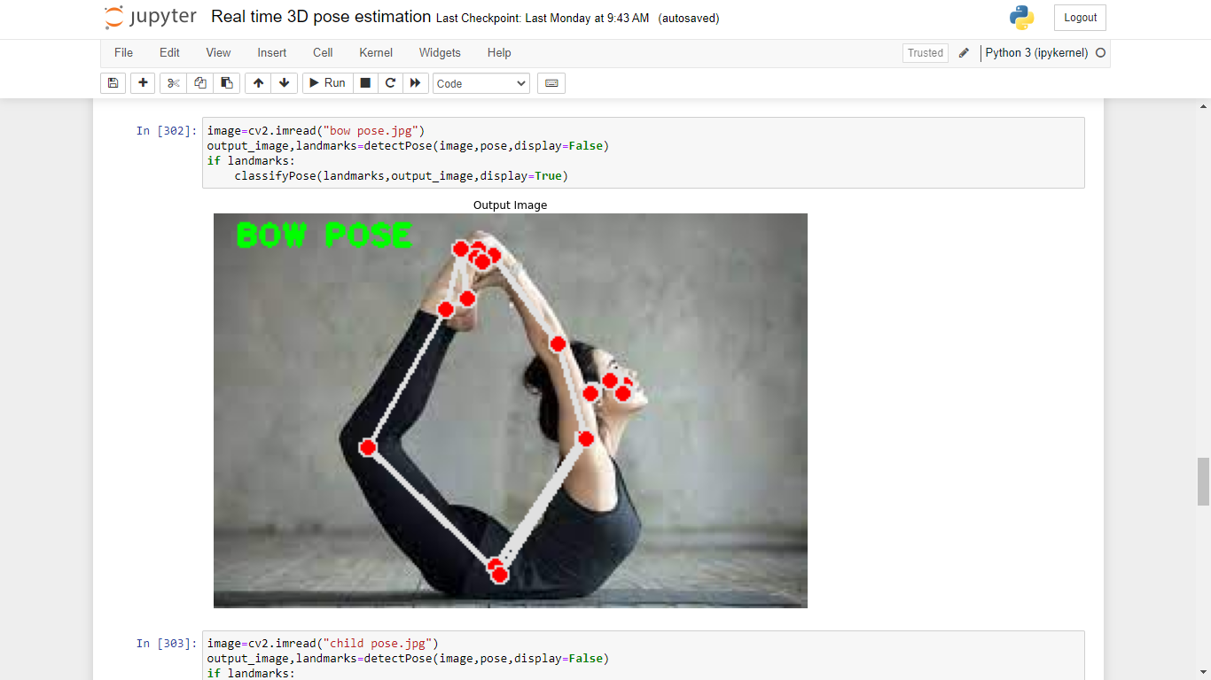
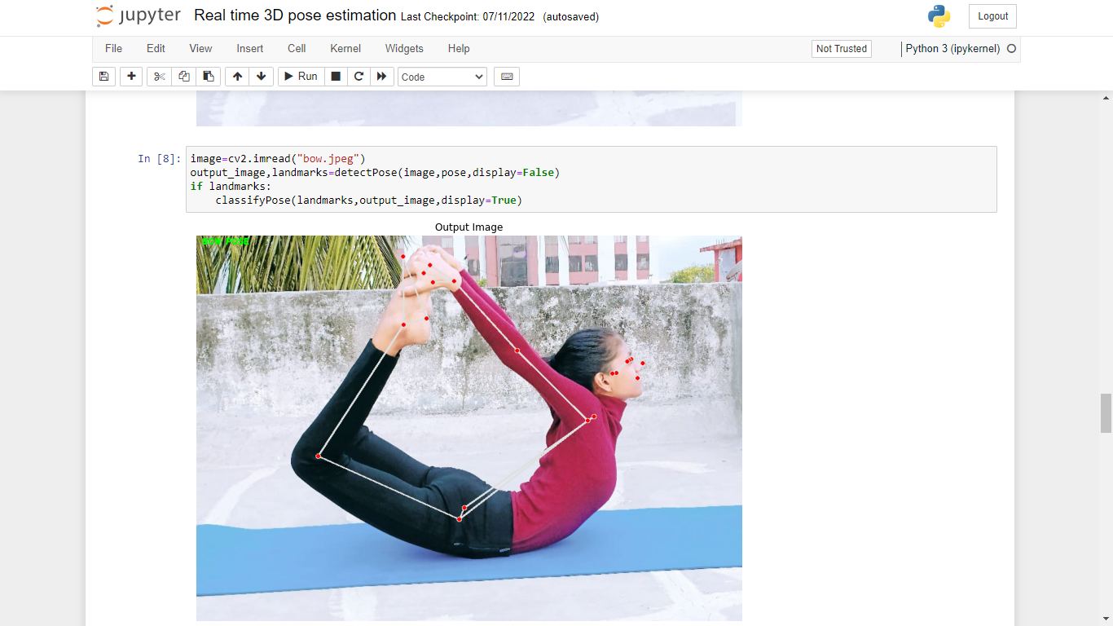
Work done (11/16)

Slide 20
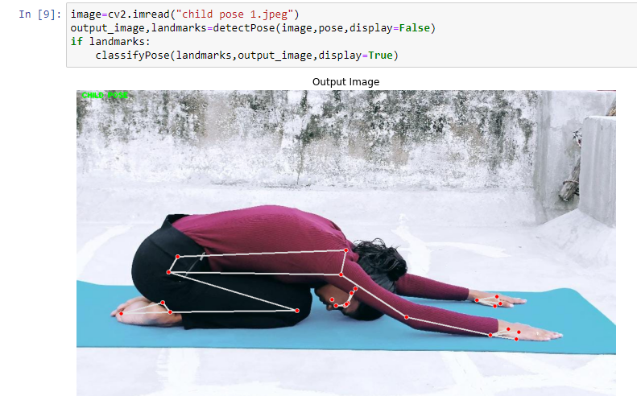
Work done (12/16)

Slide 21
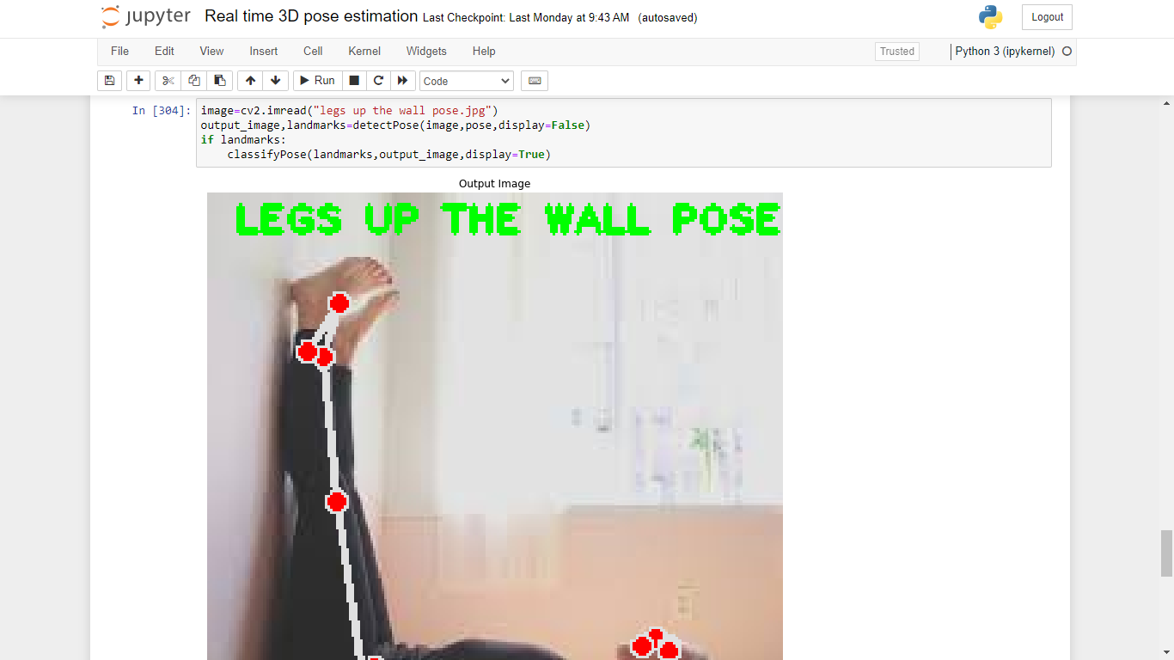
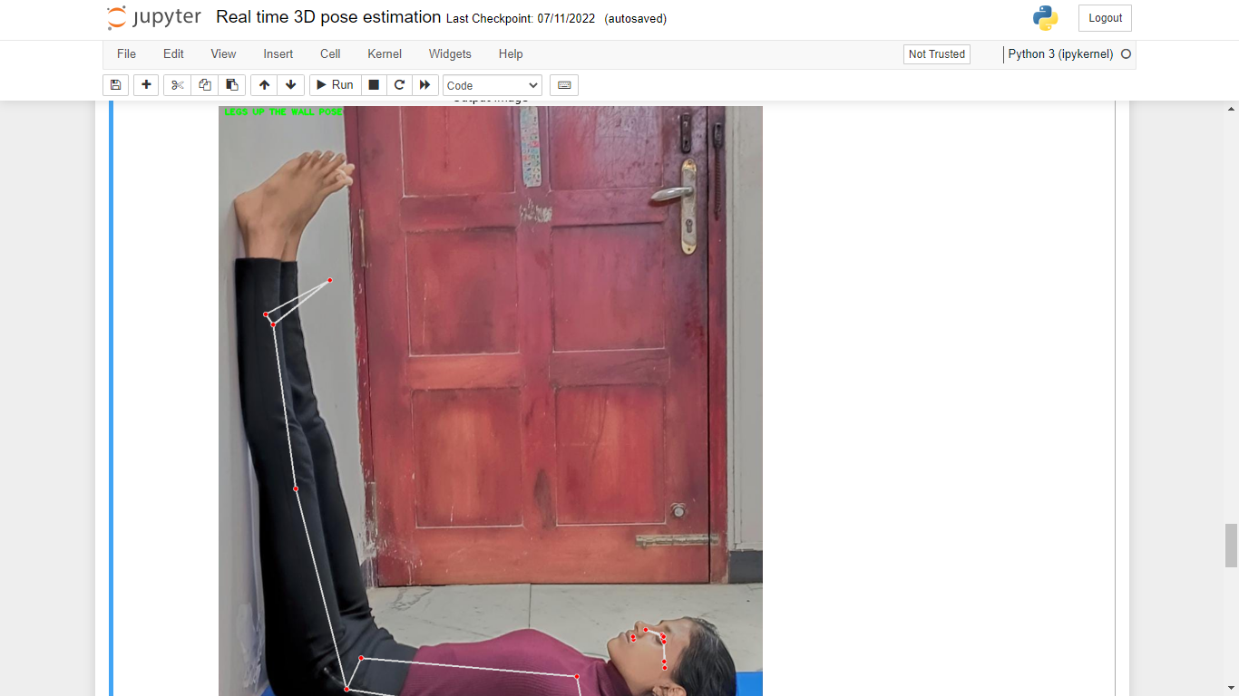
Work done (13/16)

Slide 22
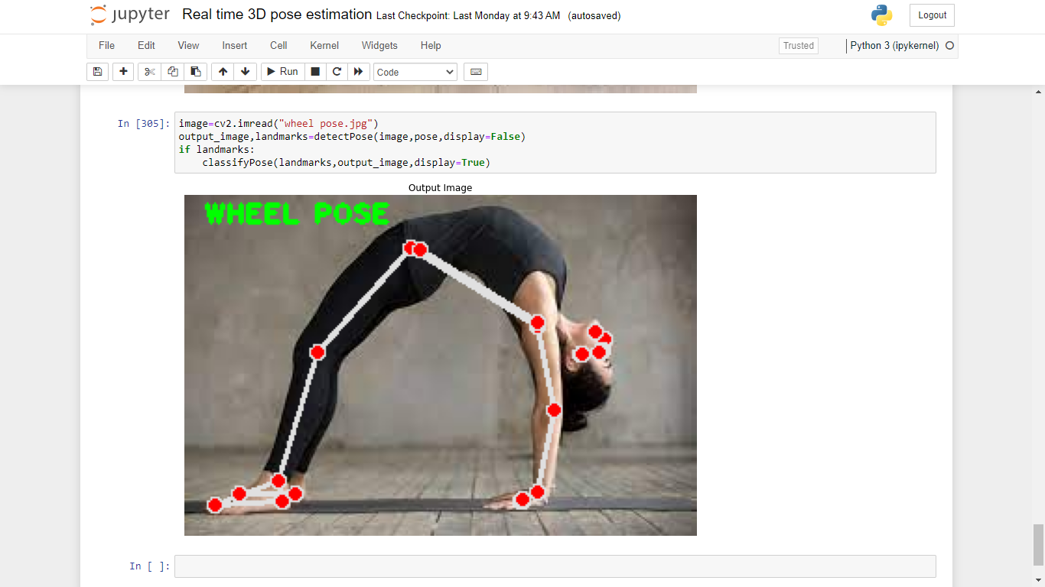
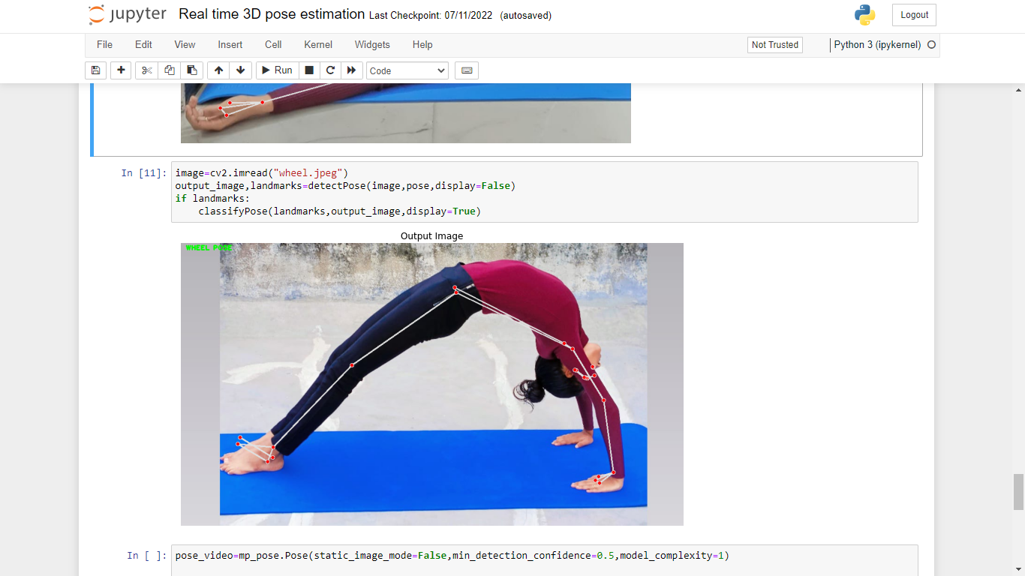
Work done (14/16)

Slide 23
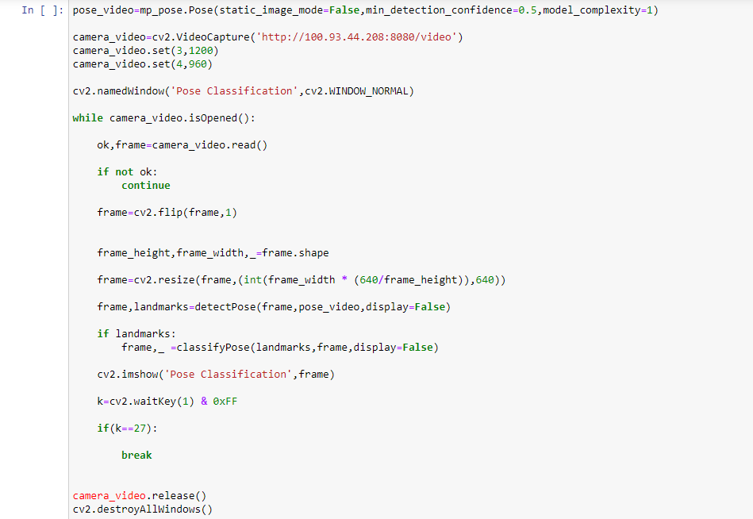
Work done (15/16)

Slide 24
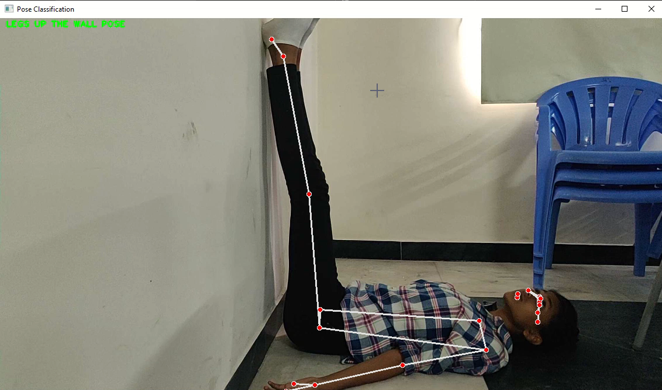
Work done (16/16)

Slide 25
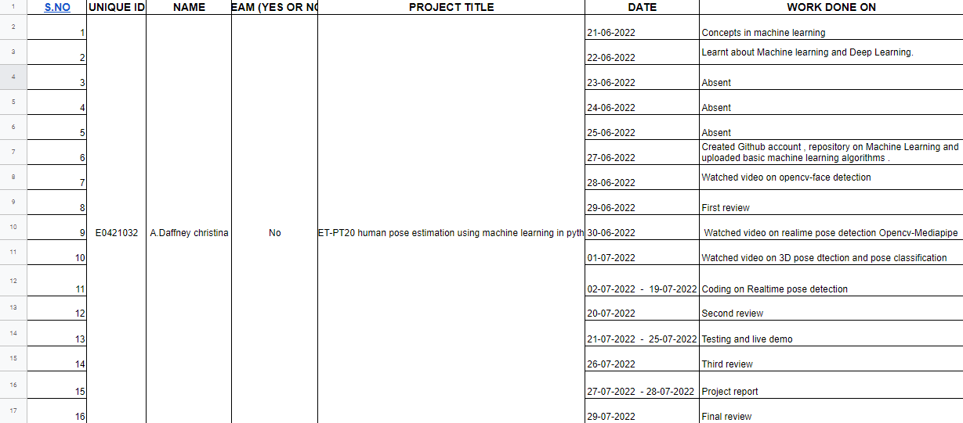
Timeline of the work

Slide 26
Reference
Websites
https://www.indiatoday.in/wellness/story/diseases-yoga-exercises-for-health-yoga-asana-medical-problems-curb-by-yoga-258533-2015-06-19
https://www.breathewellbeing.in/blog/best-yoga-asanas-for-diabetes-to-control-at-home-naturally/
https://www.mankindpharma.com/blog/benefits-of-yoga-and-8-diseases-it-can-cure
Videos
https://www.youtube.com/watch?v=-ZrDjwXZGxI
https://www.youtube.com/watch?v=T2ykss_4Af0&t=137s
https://www.youtube.com/watch?v=JetpMzU8-Pc&ab_channel=HackersRealm
https://www.youtube.com/watch?v=aySurynUNAw

Slide 27
Thank you

